Slide 1

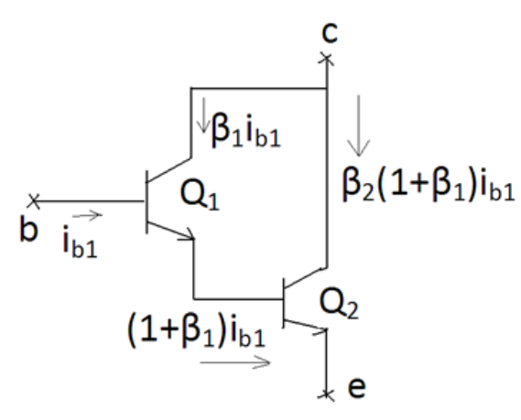



Darlington transistor uses two standard BJT (Bi-polar junction transistor) transistors which are connected together.
Darlington transistor connected in a configuration where one of transistor’s emitter provides biased current to the other transistor’s base.

Slide 2
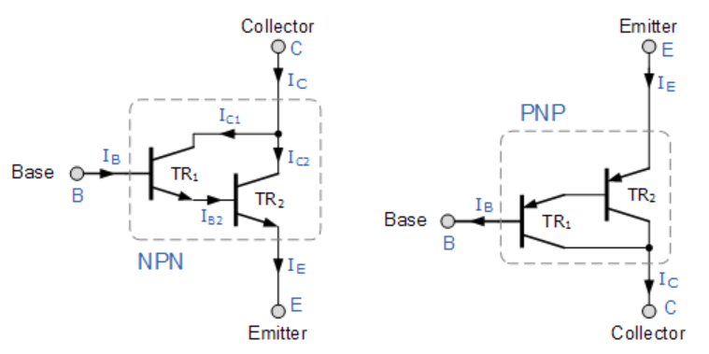
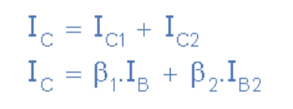
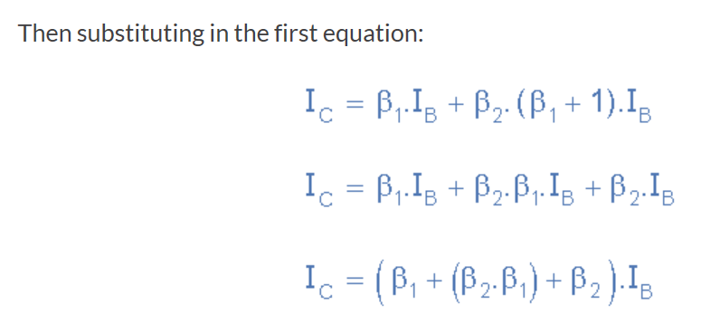


Slide 3
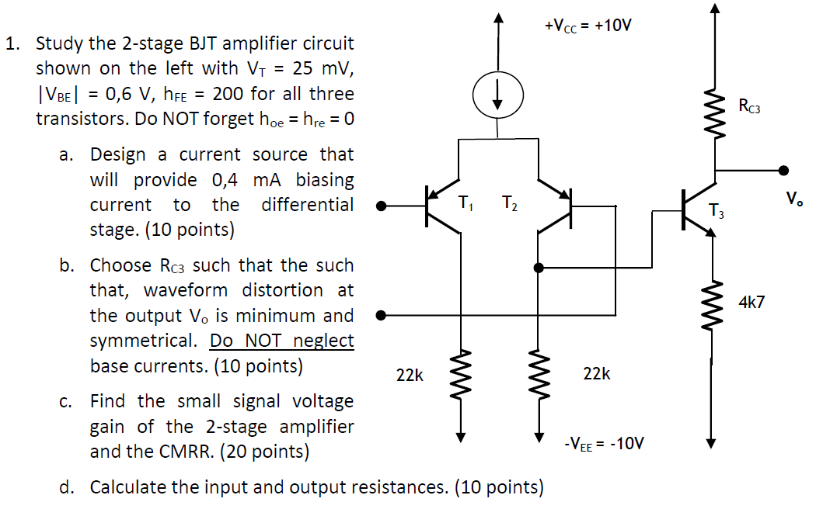
EXAMPLE

Slide 4

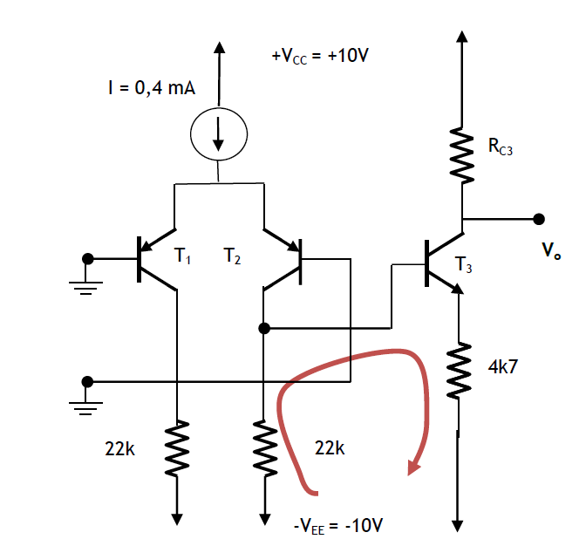

Slide 5
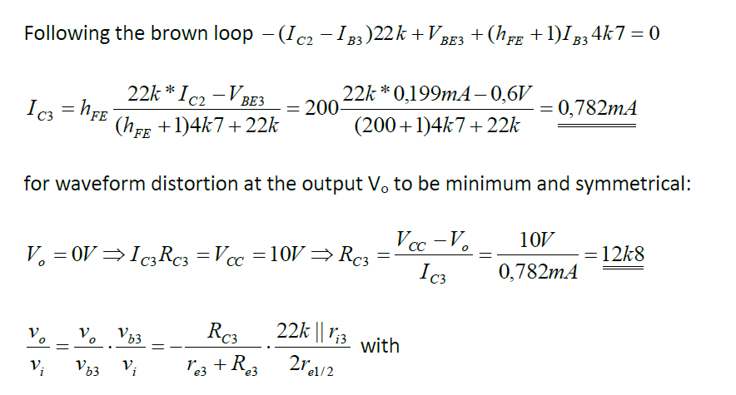

Slide 6
